Slide 1
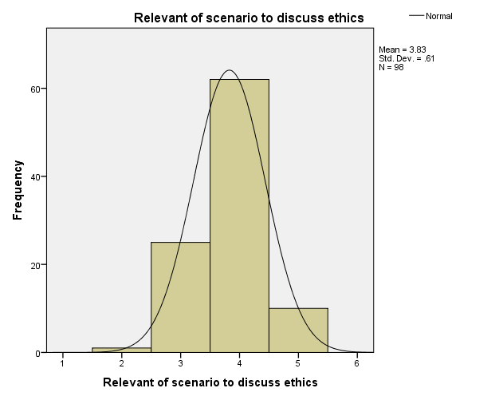
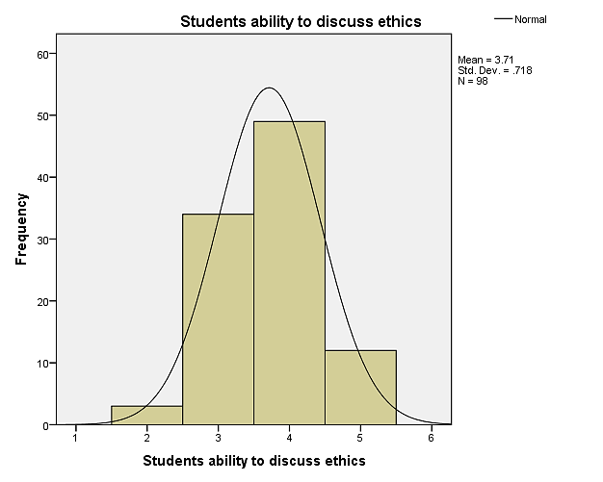
E-POSTER TITLE
Institutions Logo
Abstract ID
Presenting Author’s name, Other Authors’ Name
All authors affiliations: International Medical University Malaysia
BACKGROUND
INTRODUCTION
Brief introduction of the study
This is a sample of the poster presentations. You are free to use your own design for the presentations.
International Medical Education Conference, International Medical Education Conference, International Medical Education Conference, International Medical Education Conference, International Medical Education Conference, International Medical Education Conference
DESCRIPTION OF STUDY
Detail explanation including the initiatives etc.
This is a sample of the poster presentations. You are free to use your own design for the presentations.
International Medical Education Conference, International Medical Education Conference, International Medical Education Conference, International Medical Education Conference, International Medical Education Conference, International Medical Education Conference, International Medical Education Conference, International Medical Education Conference, International Medical Education Conference, International Medical Education Conference, International Medical Education Conference, International Medical Education Conference, International Medical Education Conference, International Medical Education Conference, International Medical Education Conference, International Medical Education Conference, International Medical Education Conference, International Medical Education Conference, International Medical Education Conference, International Medical Education Conference, International Medical Education Conference, International Medical Education Conference, International Medical Education Conference, International Medical Education Conference, International Medical Education Conference, International Medical Education Conference, International Medical Education Conference, International Medical Education Conference
OBJECTIVES
This study was done to……...(please state the objectives of the study)
METHODS
RESULTS
CONCLUSIONS
The findings shows International Medical Education Conference, International Medical Education Conference, International Medical Education Conference
It is hope that early International Medical Education Conference, International Medical Education Conference, International Medical Education Conference, International Medical Education Conference, International Medical Education Conference, International Medical Education Conference
Study Population: International Medical Education Conference
A brief explanation of the results
Research process: International Medical Education Conference, International Medical Education Conference, International Medical Education Conference, International Medical Education Conference
Table 1: Descriptive Statistics of International Medical Education Conference
 | Mean (SD)
Relevance | 3.83 (0.61)
Perceptions | 3.71 (0.72)
Usefullness | 3.95 (0.66)
Practicality | 3.97 (0.72)
Analysis: International Medical Education Conference, International Medical Education Conference, International Medical Education Conference, International Medical Education Conference International Medical Education Conference, International Medical Education Conference, International Medical Education Conference, International Medical Education Conference
REFERENCES
1. Fox E, Arnold RM, Brody B. Medical ethics education: past, present, and future. Academic Medicine. 1995;70(9):761-8.
2. Parker M. Autonomy, problem-based learning, and the teaching of medical ethics. Journal of medical ethics. 1995;21(5):305-10.
Likert Scale
Likert Scale
Figure 1: Distribution of tutor’s score on relevance of scenario
Figure 2: Distribution of tutor’s score on students’ ability
ACKNOWLEDGEMENT: (If any)

